Slide 1

Lesson 4.5: Sequential Search
Microsoft Philanthropies TEALS Program
Introduction to Computer Science
Semester 1

Slide 2
Sequential Search
After this lesson, you will be able to...
Explain the sequential search algorithm
Implement several variations of sequential search

Slide 3
Today’s Plan
Do Now
Lecture and Demonstration
It's Around Here Somewhere Activity
Debrief and wrap-up
Notes:
Duration Description
5 minutes | Welcome, attendance, bell work, announcements
15 minutes | Lecture and Demonstration
25 minutes | Activity
10 minutes | Debrief and wrap-up

Slide 4

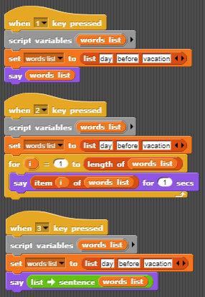
Do Now 4.5: List Tracing
For each script below, describe what the sprite does when that script is triggered.
Number your answers.
If you have time, check your answers by assembling these scripts in SNAP.
You will need to add the “Words, sentences” library to your project to use the “list->sentence” block.
In Snap:
Click the File Icon in the upper left corner next to the “Snap!” image.
Click “Libraries...”
Select “Words, sentences”
Click “Import”
The “list->sentence” block will be one of the blocks added to “Operators”

Slide 5

Lecture
How would you determine if a person is in the room or not?
Can you produce a method that will always work including when the person is not present? (Pretend you are a computer)
Notes:
Ask students to consider how to determine if a particular person is in the room or not
At first, you will likely get answers like “call out the person's name” or “look around.” Press the students to come up with a method that will always work, including when the person is not present. If necessary, ask them to pretend they are a computer.
Point out that solutions like “look around” are too high-level, and in reality, there is a lot more going on (such as looking at each person individually).
Guide students to the process of checking if each person is the one they are seeking, in some deterministic order, until they have either found the person or checked everyone. Emphasize that the absence of the person is only confirmed when everyone has been checked, but that the presence is known as soon as the person is found.
Get students to recognize that this process is a traversal of the people in the room.
Explain that the process of traversing a list looking for a particular item is known as a “sequential search.”
Ask students to think about the efficiency of this algorithm. Emphasize best, worst, and average cases (both what those cases are and how long they take).
You need not get into specific runtimes or big-O notation, but students should have a basic understanding of the fact that the speed of the search is dependent on the size of the list.
If students seem prepared, ask them to speculate under what circumstances you might be able to do better (eventually leading to binary search).
Show the code for a basic sequential search:

Slide 6
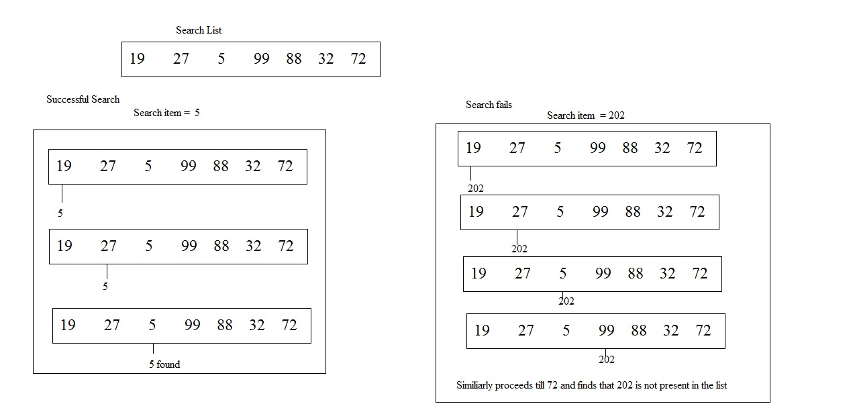
Lecture (Continued)
Notes:
Point out that this code is another variation of a traversal.
Emphasize that this is only one variant of sequential search. The specifics of what to report can vary (true/false, index in list, item itself, etc.).

Slide 7

Lab 4.5: It’s Around Here Somewhere
In this lab, you will work in pairs to implement several custom blocks performing variants of sequential search.
You there
Write your own version of the Snap! contains block, which takes a list and a value as arguments and reports true if the value is anywhere in the list and reports false otherwise.
Do not use the existing contains block in your implementation.
Notes:
Students should complete the It's Around Here Somewhere activity individually or in pairs.
Each part asks students to write a slightly different sequential search. In all cases, make sure students are clear on what they should be reporting, both when the desired item is found and when it is not.

Slide 8
Lab 4.5: It’s Around Here Somewhere – where?
Write a custom block called “index of”.
Takes a list and a value as arguments and reports the index.
Which the value is found in the list, if it is there.
If the value is not present anywhere in the list, report −1.
For example,
if the list is (2, 3, 5, 7, 11) and the value is 5, “index of” should report 3.
If the list is (2, 3, 5, 7, 11) and the value is 4, “index of” should report −1.
Do not use the existing index of block in your implementation.
Notes:
Students should complete the It's Around Here Somewhere activity individually or in pairs.
Each part asks students to write a slightly different sequential search. In all cases, make sure students are clear on what they should be reporting, both when the desired item is found and when it is not.

Slide 9
Lab 4.5: It’s Around Here Somewhere – Tell me More
Tell me more
Write a custom block called “first e-word” that takes a list as an argument and reports the first word in the list that starts with the letter 'e'. If no such word exists, report a blank (nothing).
BONUS: Write a custom block called “first word that starts with” that takes a list and a letter as arguments and reports the first word in the list that starts with the given letter. If no such word exists, report a blank (nothing).
Do not use the existing index of block in your implementation.
Notes:
Students should complete the It's Around Here Somewhere activity individually or in pairs.
Each part asks students to write a slightly different sequential search. In all cases, make sure students are clear on what they should be reporting, both when the desired item is found and when it is not.

Slide 10

Debrief
Share Out of Solutions
Notes:
Ask one or two students to provide their solutions to each part
Point out the similarities in each solution, emphasizing that the algorithm remains constant and only the value that is reported changes.

Slide 11

Exit Ticket
In your notebook answer the following,
In your own words describe how a sequential search works.
Discussion: Share what you were having trouble with.

